Slide 1
DEPARTMENT OF COMPUTER SCIENCE AND
ENGINEERING
Develop an AI System to Identify and Block
Phishing Emails
Presented by:
Angeshkumar .P - 71052202301
Anisuthan .S - 71052202007
Nathesh .P.V - 71052202303
Sanjayram .S - 71052202308
Guided by:
Ms .V. Saranya .M.E

Slide 2
Introduction
Email phishing is one of the most common and dangerous forms of cyberattacks.
Attackers trick users by sending fake emails that mimic trusted sources.
These emails often contain malicious links, fake login pages, or infected attachments.
Detecting phishing emails using Machine Learning helps automate and improve security.

Slide 3
Problem Statement
Phishing emails pose a major cybersecurity risk.
Traditional rule-based filters often fail against sophisticated attacks.
Need for a reliable, automated system to identify phishing emails in real time.
Increasing volume and complexity of phishing emails demand intelligent, scalable solutions

Slide 4
Objectives
Detect phishing emails using an intelligent machine learning model.
Improve detection accuracy with XG-Boost and TF-IDF feature extraction.
Develop a real-time, web-based system to classify emails as phishing or legitimate.
Minimize false positives and false negatives to ensure reliable results.
Provide a user-friendly interface for non-technical users to easily test email safety.

Slide 5
Existing Systems
Rule-based Spam Filters And Keyword Detection Are Commonly Used.
These Systems Are Limited In Flexibility And Fail Against New Or Obfuscated Phishing Techniques.
High False Negatives And Undetected Threats Remain A Major Concern. Give More For This Slide.
Naïve Bayes Algorithm Is Slow And Low Accuracy

Slide 6
Algorithms
Naïve Bayes: Simple and fast probabilistic classifier.
Logistic Regression: Effective for binary email classification.
SVM: Finds the best boundary between phishing and safe emails.
Random Forest: Combines multiple trees for better accuracy.
XG-Boost: Powerful and fast gradient boosting method.

Slide 7
Algorithm Comparison
Algorithm | Accuracy (%) | Speed
Naïve Bayes | 91% | Very Fast
Logistic Regression | 95% | Fast
Support Vector Machine (SVM) | 93% | Moderate
Random Forest | 94% | Moderate
XGBoost | 96% | Fast

Slide 8
Proposed System
Apply ML algorithms to detect phishing emails.
Use TF-IDF, metadata analysis, and XG-Boost for accurate classification.
Web-based interface for real-time spam/phishing detection.
Store model and vectorizer using Pickle for efficient deployment.

Slide 9
KEY FEATURE
Robust Model-Uses XG-Boost for accurate phishing detection.
Feature Extraction-Analyzes email content and metadata.
Fast & Scalable-Handles large volumes efficiently.
User-Friendly-Easy and intuitive interface.
Low False Positives-Reduces incorrect alerts.
Adaptable-Ready for new features and upgrades.

Slide 10
System Architecture
Input: User submits email content via web form.
Preprocessing: Clean and tokenize the email text.
Feature Extraction: Use TF-IDF to convert text into numerical features.
Prediction: XG-Boost model classifies the email as phishing or legitimate.
Output: Result is displayed instantly on the web interface.
Deployment: Model and vectorizer are loaded using Pickle through Flask.

Slide 11
Technologies Used
Python: Core programming language for implementation
Flask: Lightweight web framework for backend/API
Scikit-learn & XG-Boost: ML libraries for training and prediction
Pandas & NumPy: Data handling and numerical operations
TF-IDF (TfidfVectorizer): Text feature extraction
Pickle: Saving and loading trained models
HTML/CSS: Frontend design for user interface
CSV: Dataset storage and input format

Slide 12
Implementation
Merged and labeled phishing and ham emails from multiple datasets.
Applied preprocessing (cleaning, tokenization) and TF-IDF vectorization on email text.
Trained several models XG-Boost selected best-performing model.
Built a Flask-based web app for real-time prediction with a simple user interface.
Stored trained model and vectorizer using Pickle for fast deployment and reuse.

Slide 13
Modules
Data Preprocessing Module – Clean, tokenize, and normalize email content
Feature Extraction Module (TF-IDF) – Convert emails into numerical feature vectors
Model Training Module (XG-Boost) – Train classifier to detect phishing patterns
Web Interface (Flask + HTML) – User-friendly portal for email input
Result Display & Feedback – Show prediction results and gather feedback

Slide 14
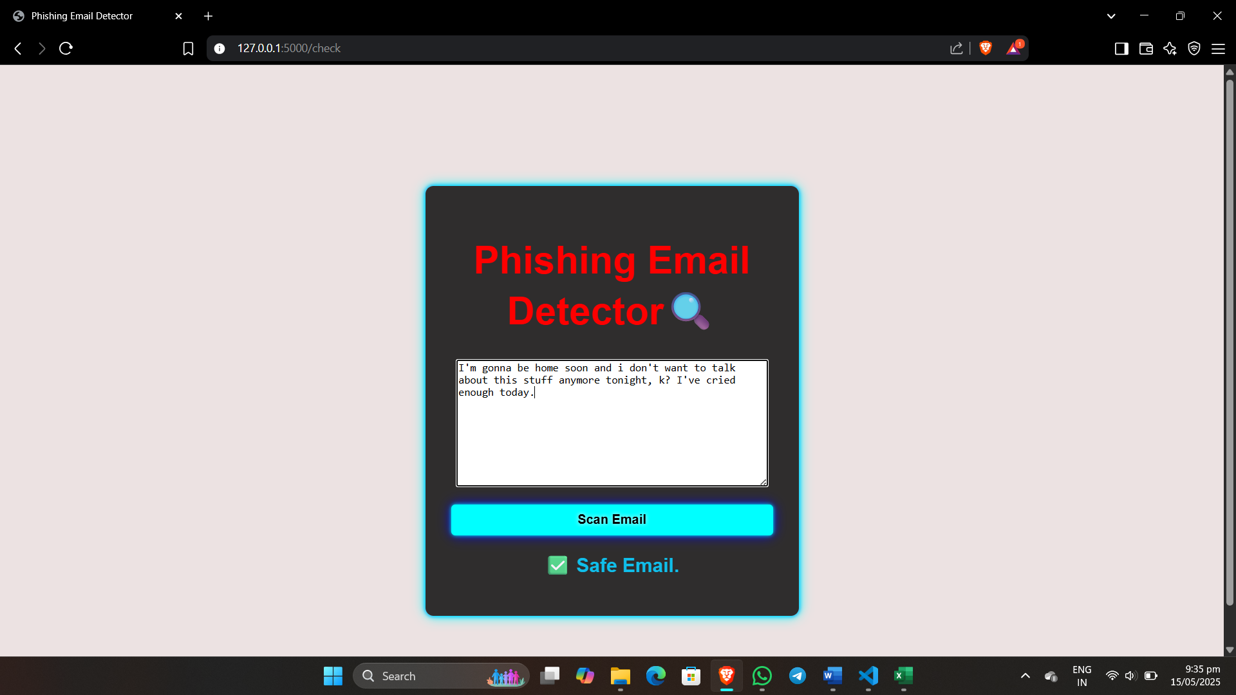
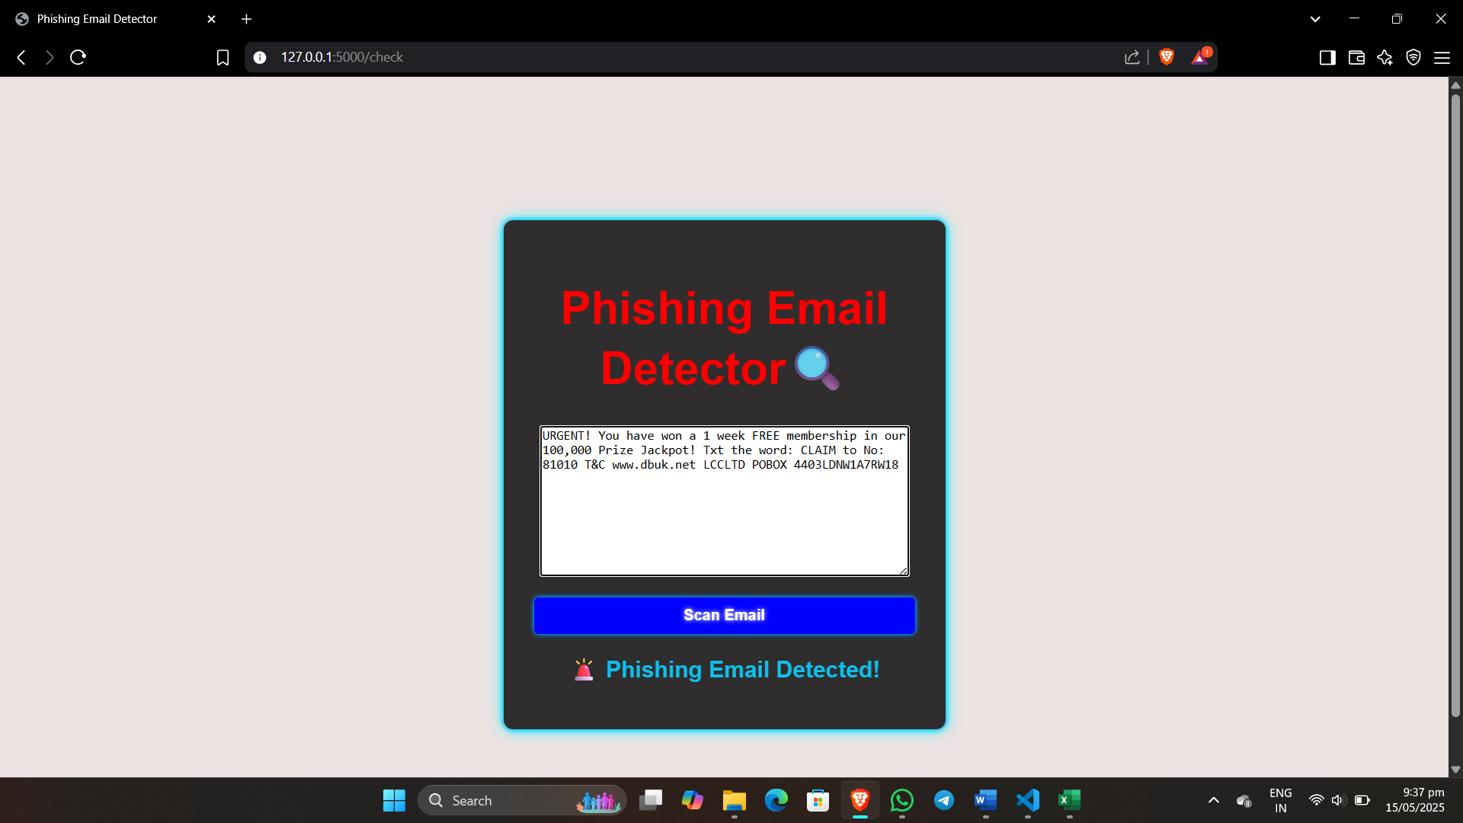
Output/Screenshots

Slide 15
Conclusion
Developed an intelligent phishing detection system powered by XG-Boost.
Delivers fast and accurate identification of phishing emails.
Features a user-friendly interface for seamless operation.
System is prepared for real-world deployment and integration with email platforms.
Shows strong potential to enhance email security and protect users effectively

Slide 16
Future Work
Enhance Analysis
Incorporate email header details and URL behavior for better detection accuracy.
Adopt Deep Learning
Use advanced models like BERT and LSTM to improve phishing detection performance.
Support Multilingual Emails
Expand the system to detect phishing in multiple languages.
Cloud & Client Deployment
Deploy the detection system on cloud platforms and integrate with popular email clients for real-time protection.

